Slide 1
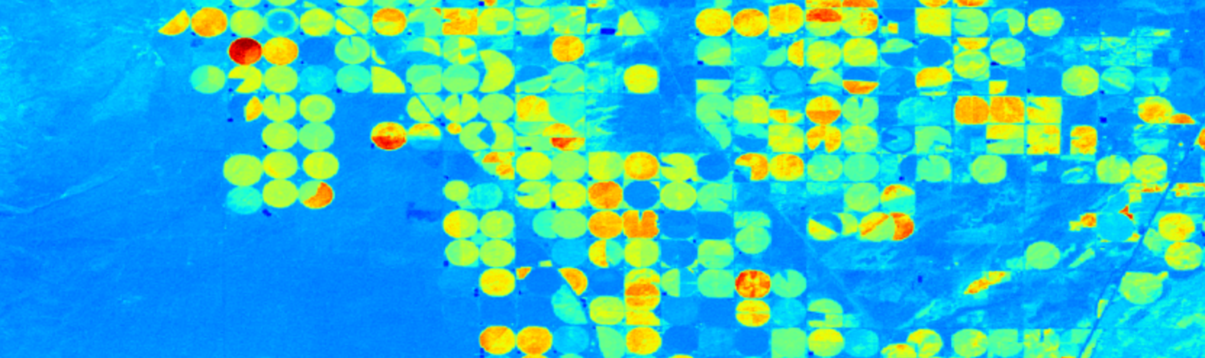
Capstone: Part 4
Byron Allen
Data Science Student at General Assembly
14 October 2016

Slide 2
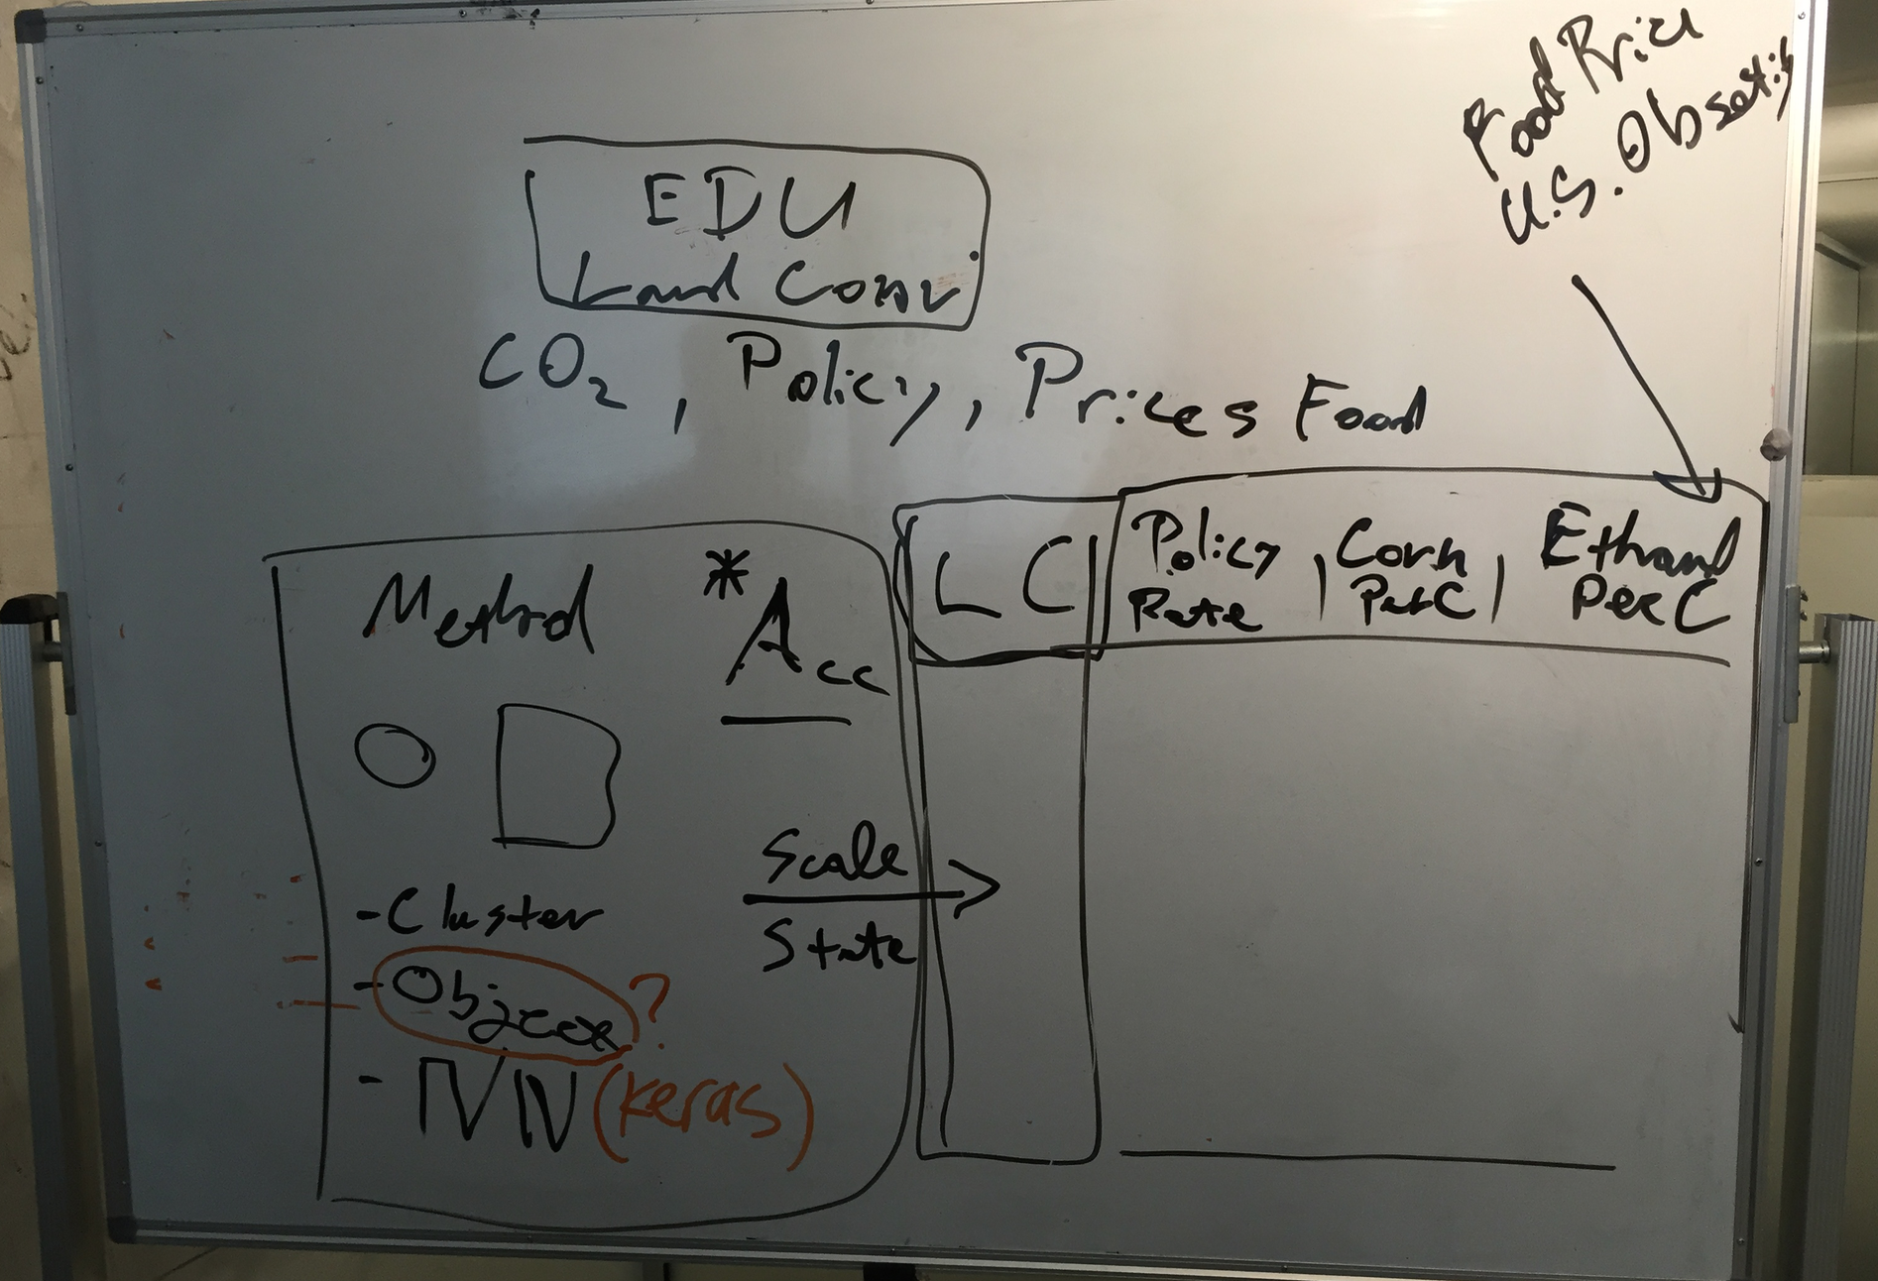
Master Plan

Slide 3
Workflow(s)
Obtain Landsat 8 32-Day EVI (1 band)
Obtain Landsat 8 8-Day Raw (12 bands)
Create Ag Mask based on the highest EVI readings
Develop vegetation array and bare earth array from raw bands
Subtract bare earth from vegetation array to produce new vegetation array
Run KMeans (k=30) on new vegetation array
Apply centroid-based labels (not out-of-box labels)
Overlay Ag Mask
Consolidate classes as needed
Train then test unsupervised methods
Apply model to next layer of data
Obtain Landsat 8 32-Day Raw (12 bands)
Develop vegetation array and bare earth array from raw bands
Subtract bare earth from vegetation array to produce new vegetation array
Flatten array for each month of a year
Train on year 1 and test on year 2
Apply model to next layer of data
Obtain Landsat 8 8-Day Raw (12 bands)
Agglomerative Cluster / Affinity Propagation

Slide 4

Outliers? More Like Obstacle

Slide 5
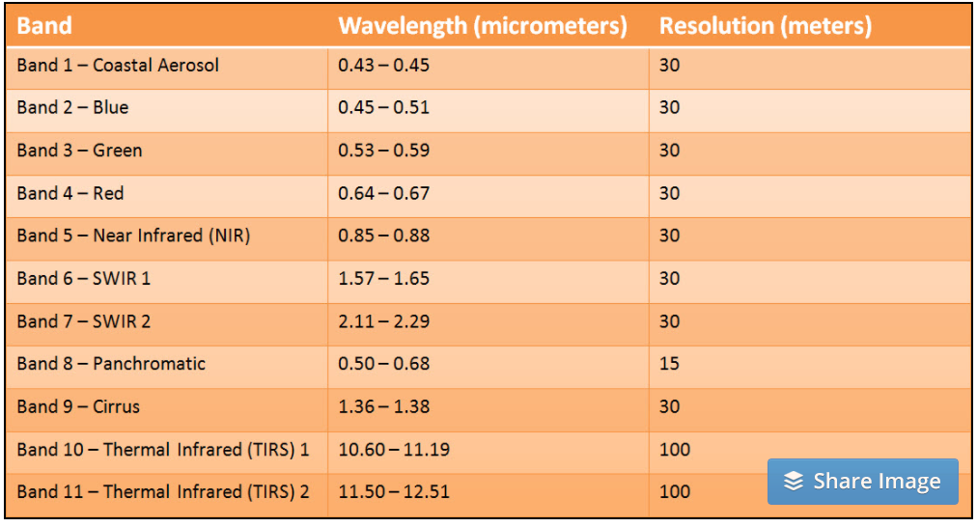
Variables

Slide 6
Engineered Features
Vegetation Array = (band_6 + band_5 + band_2) / 3
Bare Earth Array = (band_6 + band_3 + band_2) / 3
Ag Mask = EVI > 0.45
Ag Mask Applied & Clusters Clumped
Vegetation Array – Bare Earth Array

Slide 7
Model Selection and Implementation
KMeans to generate labels
Exploring supervised methods for next steps

Slide 8
Data Pipelines
Google Earth Engine (GEE)
Landsat 8 8-Day Raw
Landsat 8 32-Day EVI
Landsat 8 32-Day Raw Composite
Use Javascript to work with GEE’s code editor
Locations
Colorado
Nebraska
Florida

Slide 9
Visualizations & Statistical Analysis
TBC

Slide 10
Results
TBC

Slide 11
Source Code

Slide 12
Recommendations/Next Stpes
Better ag masks
Sort out agglomerative clustering
Test second workflow

